Slide 1
Homework 1 Recap
(I graded them. It’s faster and I like to understand why you are missing.)
Problem | 1 | 2 | 3 | 4 | 5 | 6 | Total
Points Worth | 3 | 3 | 4 | 4 | 3 | 3 | 20
Average | 2.92 | 2.375 | 3.07 | 2.42 | 2.67 | 1.83 | 15.28
Percentage | 0.97 | 0.79 | 0.77 | 0.60 | 0.89 | 0.61 | 0.76 (B)
If you didn’t do as well as you’d like, don’t worry. You’ll have to really do bad to get a C. However, an A is not guaranteed. I’m not opposed to a lot of A’s, but you’ll have to earn them.
Let’s discuss 4 and 6.
I think I put enough comments on the rest to help you understand what’s right, but I encourage you to chat with your classmates about other problems you don’t know and/or discuss them with me in office hours (Wednesdays).
Notes:
I generally prefer not to have a TA grade these.
They are slow.
I like to see what you are missing so that I can make sure to address the most important points.

Slide 2
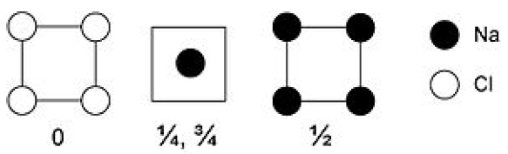
Problem 6
Could have a similar problem on Test 1
(I’d rather you put your homework away while we discuss these. I want you to think with us now rather than look at what you did.)
How many Cl are there?
Cl at all of the corners, 8 corners shared between 8 unit cells (just like sc), so 1 Na per cell
How about the Na?
Na: 2 within the unit cell not shared with other cells and 4 edges (shared with 4) so 3 Na per cell
Thus Na₃Cl

Slide 3
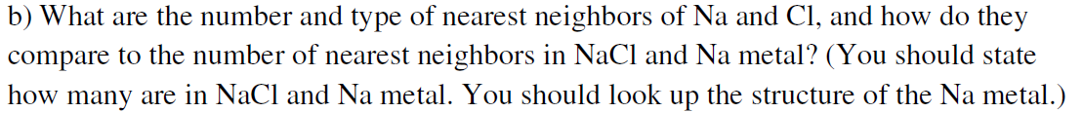
Problem 6
Na metal. What is the crystal structure? (Look up)
BCC. How many nearest neighbors?
8
NaCl. How many nearest neighbors?
6
Where are the nearest neighbors closest to Cl in Na₃Cl?
Those body Na atoms. How many?
8
Let’s look at those body Na. Where are their neighbors?
How many and what type?
4 Na and 4 Cl
Is that the same for the edge Na?
No. How many and what type for the edge Na?
8 Na

Slide 4
Problem 4 (SnTe)
Could have a similar problem on Test 1
Any of the homework problems is a reasonable test question.
Identify the crystal structure, which means identifying both the lattice and the basis. The basis should include the location of each atom in the primitive unit cell and only those atoms necessary (no redundancies). Write down primitive lattice vectors.
This crystal structure should look familiar, as it is rock salt (discussed in class).
FCC lattice, must list fcc primitive lattice parameters for full points
Basis: Sn at (0,0,0) and Te at (1/2, 0, 0) or vice versa (doesn’t matter)
b. In this structure, identify which ions are cations and which are anions. Identify the amount of missing/extra electrons you expect for each ion type. How should we figure this out?
Need to look at Appendix 2 to see what the ionic forms of Sn and Te are. Sn 4- or 4+, Te 2- or 4+.
Only one matching set. The crystal structure has to be charge neutral. Sn4- and Te 4+, thus Sn is the anion with 4 extra electrons and Te the cation with 4 missing electrons.

Slide 5
Problem 4 (SnTe)
c. Utilize the provided appendix to determine the ionic packing factor of this crystal structure. (Note that the atomic radii will be different so think about how you adjust from the type of procedure you used in problem 1.)
What do we need to figure out?
the number of atoms in the cell and how to relate a and the radii.
Let’s start with how to relate the radii to a. Where do the atoms come closest?
How do we deal with this number of atoms? How many of each type do we have in the conventional unit cell of fcc?

Slide 6
Test Study Advice
The homeworks and problems in class are really great examples of the types of test questions I could ask, so I recommend you use those for review. Good to look back through lectures/recordings to help study.
Test 1: September 16, in class

Slide 7
For a little more practice:
In Class Challenge (Form Your Group)
We’re going to have a little challenge to see which group can get the correct stoichiometry of my mystery crystal structure first.
Do not shout them out. You must turn in your answers by paper to get the prize.
I might let you guess more than once, but there will be a delay until second guesses.

Slide 8
Rest of Today’s Goal:
Start to Understand Reciprocal Space
It will take a few lectures before we really get comfortable with it.
I’ve had graduate students who had taken a class like this at another university who still didn’t understand it. Thus, it will take a little bit before this is likely to totally sink in for you.

Slide 9
The Reciprocal Lattice
Is a useful tool to handle the diffraction of waves
Used to describe all things of “wavy nature” including electrons and lattice vibrations
Is used to represent band structure
Is the collection of all wave vectors G that yield plane waves with a period of the Bravais lattice (What does period of lattice mean? Any R= u₁ a₁+u₂ a₂+u₃ a₃ vectors is a possible period of the Bravais lattice)
It can be shown that G = K (Laue condition). I’ll use both G and K (heads up).

Slide 10
Reciprocal Space =
Fourier transform of the real crystal lattice. Also called Fourier space, k-space, wavevector space or momentum space
In contrast to real space or direct space.

Slide 11
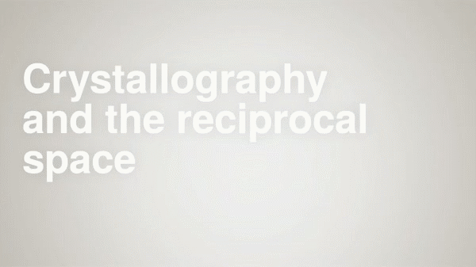
Watch this short video: https://www.youtube.com/watch?v=DFFU39A3fPY
Notes:
https://www.youtube.com/watch?v=DFFU39A3fPY

Slide 12
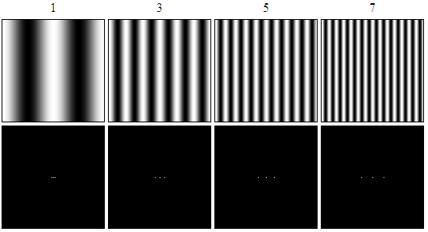
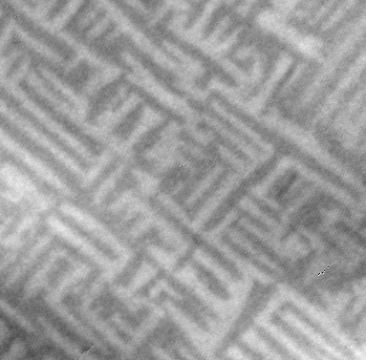
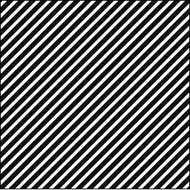
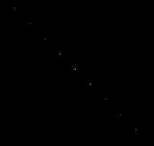
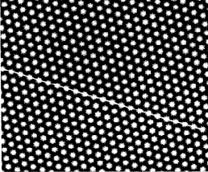
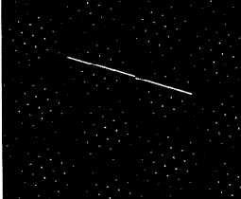
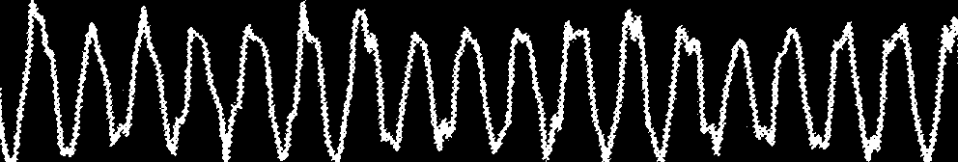
Examples of Image Fourier Transforms
Real Image
Fourier Transform
Brightest side points relating to the frequency of the stripes
Notes:
Moved from just before BCC example, due to timing constraints
Cannot see dots on projector-recreate the bottom left one. (tried to change contrast to help)
What if you take fourier transform of something that isn’t lines? What is the fading due to? This is edging effects from the fact that our image size is finite.
A transformed image can be used for frequency filtering.
In images 1,3,5,7: Only three spots are shown to focus on change in distance between real and reciprocal, but more would appear just as in the first set of images.
Here is an image I took as a graduate student of the antiferromagnetic domains of a material. I could take a fourier transform to tell me about the average length scales of these domains and their varience.

Slide 13
The Reciprocal Lattice
Crystal planes (hkl) in the real-space (or the direct lattice) are characterized by the normal vector and d_{hkl} interplanar spacing
z
y
[hkl]
x
Notes:
What plane is this? (010)
This was why we discussed the distance between planes before.
K is also often called G

Slide 14
The Reciprocal Lattice
Crystal planes (hkl) in the real-space (or the direct lattice) are characterized by the normal vector and d_{hkl} interplanar spacing
z
y
[hkl]
x
Practice has shown the usefulness of defining a different lattice in reciprocal space whose points lie at positions given by the vectors
This vector has magnitude 2π/d_{hkl}, which is a reciprocal distance
Notes:
What plane is this? (010)
This was why we discussed the distance between planes before.
K is also often called G

Slide 15
The Reciprocal Lattice
Crystal planes (hkl) in the real-space (or the direct lattice) are characterized by the normal vector and d_{hkl} interplanar spacing
z
y
[hkl]
x
Practice has shown the usefulness of defining a different lattice in reciprocal space whose points lie at positions given by the vectors
This vector has magnitude 2π/d_{hkl}, which is a reciprocal distance
A point in the reciprocal lattice corresponds to a set of planes (hkl) in the real-space lattice.
Notes:
What plane is this? (010)
This was why we discussed the distance between planes before.
K is also often called G

Slide 16
Definition of the Real/Reciprocal Lattice
R_{n} = n₁ a₁ + n₂ a₂ + n₃ a₃ (real lattice vectors a₁,a₂,a₃)
(h, k, l integers)
Suppose K can be decomposed into reciprocal lattice vectors:
b’s are defined such that:
Note: a has dimensions of length, b has dimensions of length⁻¹
Implication: b₁ is always perpendicular to a₂ and a₃
The basis vectors b_{i} define a reciprocal lattice:
+ cyclic permutations
Notes:
Removed K dot R = 2 pi times integer. Seemed more direct to just say b’s defined this way. (perhaps leaving it in will make the diffraction click better later, but I don’t think it makes a big difference)
We discussed before that any vector in real space pointing from one lattice point to another can be written in terms of integers times the real space lattice vectors. We will find we can do the same thing in reciprocal space.
What does it mean that a1 dot b1 equals 2pi and a1 dot b2 or b3=0?
That means a1 is perpendicular to b2 and b3, but not necessarily parallel to a1 (but it could be).
Anyone know what a1 dot (a2 cross a3) is? Let’s look at it in the simple cubic case.
Continue to think about simple cubic structure: Lattice vectors are not unique, but the primitive unit cell always has the same volume.

Slide 17
Definition of the Real/Reciprocal Lattice
R_{n} = n₁ a₁ + n₂ a₂ + n₃ a₃ (real lattice vectors a₁,a₂,a₃)
(h, k, l integers)
Suppose K can be decomposed into reciprocal lattice vectors:
b’s are defined such that:
Note: a has dimensions of length, b has dimensions of length⁻¹
Implication: b₁ is always perpendicular to a₂ and a₃
The basis vectors b_{i} define a reciprocal lattice:
+ cyclic permutations
is volume of unit cell
Notes:
Removed K dot R = 2 pi times integer. Seemed more direct to just say b’s defined this way. (perhaps leaving it in will make the diffraction click better later, but I don’t think it makes a big difference)
We discussed before that any vector in real space pointing from one lattice point to another can be written in terms of integers times the real space lattice vectors. We will find we can do the same thing in reciprocal space.
What does it mean that a1 dot b1 equals 2pi and a1 dot b2 or b3=0?
That means a1 is perpendicular to b2 and b3, but not necessarily parallel to a1 (but it could be).
Anyone know what a1 dot (a2 cross a3) is? Let’s look at it in the simple cubic case.
Continue to think about simple cubic structure: Lattice vectors are not unique, but the primitive unit cell always has the same volume.

Slide 18
Definition of the Real/Reciprocal Lattice
R_{n} = n₁ a₁ + n₂ a₂ + n₃ a₃ (real lattice vectors a₁,a₂,a₃)
(h, k, l integers)
Suppose K can be decomposed into reciprocal lattice vectors:
b’s are defined such that:
Note: a has dimensions of length, b has dimensions of length⁻¹
Implication: b₁ is always perpendicular to a₂ and a₃
The basis vectors b_{i} define a reciprocal lattice:
+ cyclic permutations
is volume of unit cell
Definition of a’s are not unique, but the primitive volume is.
Notes:
Removed K dot R = 2 pi times integer. Seemed more direct to just say b’s defined this way. (perhaps leaving it in will make the diffraction click better later, but I don’t think it makes a big difference)
We discussed before that any vector in real space pointing from one lattice point to another can be written in terms of integers times the real space lattice vectors. We will find we can do the same thing in reciprocal space.
What does it mean that a1 dot b1 equals 2pi and a1 dot b2 or b3=0?
That means a1 is perpendicular to b2 and b3, but not necessarily parallel to a1 (but it could be).
Anyone know what a1 dot (a2 cross a3) is? Let’s look at it in the simple cubic case.
Continue to think about simple cubic structure: Lattice vectors are not unique, but the primitive unit cell always has the same volume.

Slide 19
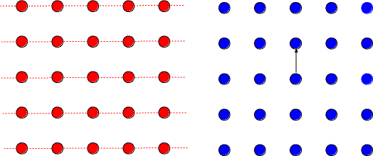
Identify these planes
a₂
a₁
Real lattice planes (hk0)
K in reciprocal space
Notes:
Planes defined by perpendicular vector.
(01) Or (010), don’t have to put in third dimension
Compare distance in real space for (01) and (11): a to 1.41a/2 or about .7a
What planes are these? Easier to tell from k space. (12)

Slide 20
2D Reciprocal Lattice
A point in the reciprocal lattice corresponds to a set of planes (hkl) in the real-space lattice.
a₂
a₁
Real lattice planes (hk0)
K in reciprocal space
K_{hkl} is perpendicular to (hkl) plane
Notes:
Planes defined by perpendicular vector.
(01) Or (010), don’t have to put in third dimension
Compare distance in real space for (01) and (11): a to 1.41a/2 or about .7a
What planes are these? Easier to tell from k space. (12)

Slide 21
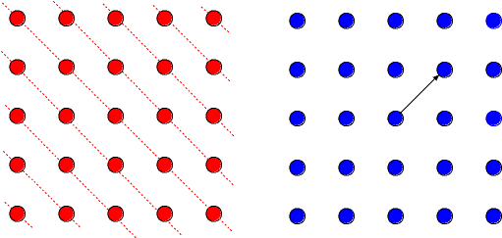
2D Reciprocal Lattice
A point in the reciprocal lattice corresponds to a set of planes (hkl) in the real-space lattice.
a₂
a₁
Real lattice planes (hk0)
K in reciprocal space
K_{hkl} is perpendicular to (hkl) plane
Magnitude of K is inversely proportional to distance between (hkl) planes
Notes:
Planes defined by perpendicular vector.
(01) Or (010), don’t have to put in third dimension
Compare distance in real space for (01) and (11): a to 1.41a/2 or about .7a
What planes are these? Easier to tell from k space. (12)

Slide 22
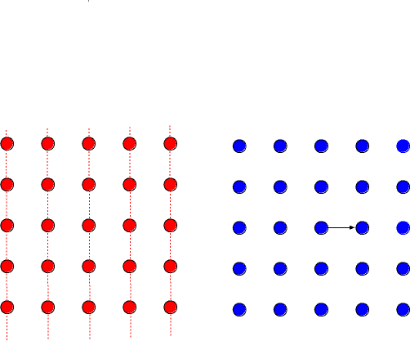
2D Reciprocal Lattice
A point in the reciprocal lattice corresponds to a set of planes (hkl) in the real-space lattice.
a₂
a₁
Real lattice planes (hk0)
K in reciprocal space
K_{hkl} is perpendicular to (hkl) plane
Magnitude of K is inversely proportional to distance between (hkl) planes
Notes:
Planes defined by perpendicular vector.
(01) Or (010), don’t have to put in third dimension
Compare distance in real space for (01) and (11): a to 1.41a/2 or about .7a
What planes are these? Easier to tell from k space. (12)

Slide 23
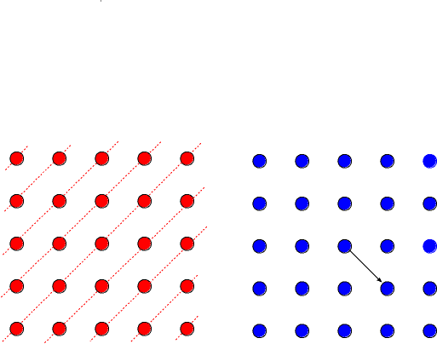
2D Reciprocal Lattice
A point in the reciprocal lattice corresponds to a set of planes (hkl) in the real-space lattice.
a₂
a₁
Real lattice planes (hk0)
K in reciprocal space
K_{hkl} is perpendicular to (hkl) plane
Magnitude of K is inversely proportional to distance between (hkl) planes
Notes:
Planes defined by perpendicular vector.
(01) Or (010), don’t have to put in third dimension
Compare distance in real space for (01) and (11): a to 1.41a/2 or about .7a
What planes are these? Easier to tell from k space. (12)

Slide 24
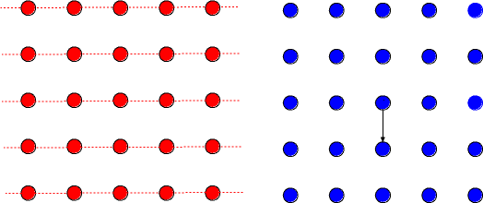
2D Reciprocal Lattice
A point in the reciprocal lattice corresponds to a set of planes (hkl) in the real-space lattice.
a₂
a₁
Real lattice planes (hk0)
K in reciprocal space
K_{hkl} is perpendicular to (hkl) plane
Magnitude of K is inversely proportional to distance between (hkl) planes
Notes:
Planes defined by perpendicular vector.
(01) Or (010), don’t have to put in third dimension
Compare distance in real space for (01) and (11): a to 1.41a/2 or about .7a
What planes are these? Easier to tell from k space. (12)

Slide 25
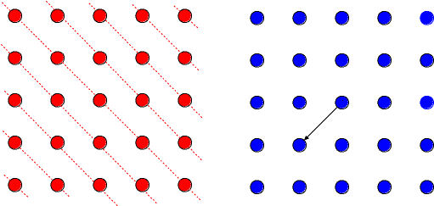
2D Reciprocal Lattice
A point in the reciprocal lattice corresponds to a set of planes (hkl) in the real-space lattice.
a₂
a₁
Real lattice planes (hk0)
K in reciprocal space
K_{hkl} is perpendicular to (hkl) plane
Magnitude of K is inversely proportional to distance between (hkl) planes
Notes:
Planes defined by perpendicular vector.
(01) Or (010), don’t have to put in third dimension
Compare distance in real space for (01) and (11): a to 1.41a/2 or about .7a
What planes are these? Easier to tell from k space. (12)

Slide 26
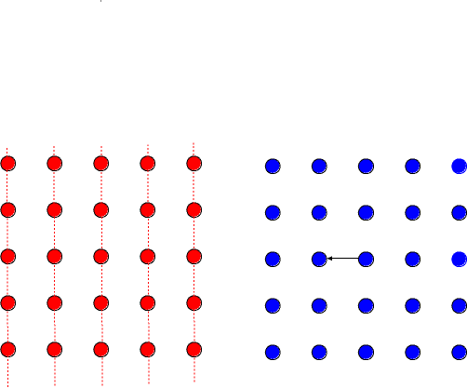
2D Reciprocal Lattice
A point in the reciprocal lattice corresponds to a set of planes (hkl) in the real-space lattice.
a₂
a₁
Real lattice planes (hk0)
K in reciprocal space
K_{hkl} is perpendicular to (hkl) plane
Magnitude of K is inversely proportional to distance between (hkl) planes
Notes:
Planes defined by perpendicular vector.
(01) Or (010), don’t have to put in third dimension
Compare distance in real space for (01) and (11): a to 1.41a/2 or about .7a
What planes are these? Easier to tell from k space. (12)

Slide 27
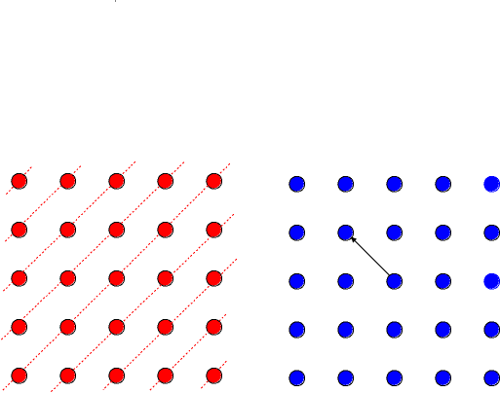
2D Reciprocal Lattice
A point in the reciprocal lattice corresponds to a set of planes (hkl) in the real-space lattice.
a₂
a₁
Real lattice planes (hk0)
K in reciprocal space
K_{hkl} is perpendicular to (hkl) plane
Magnitude of K is inversely proportional to distance between (hkl) planes
Notes:
Planes defined by perpendicular vector.
(01) Or (010), don’t have to put in third dimension
Compare distance in real space for (01) and (11): a to 1.41a/2 or about .7a
What planes are these? Easier to tell from k space. (12)

Slide 28
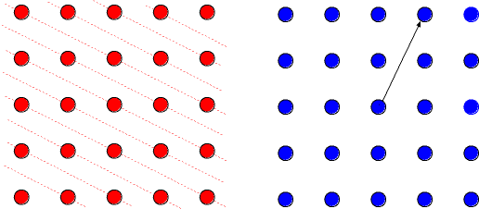
2D Reciprocal Lattice
A point in the reciprocal lattice corresponds to a set of planes (hkl) in the real-space lattice.
a₂
a₁
Real lattice planes (hk0)
K in reciprocal space
K_{hkl} is perpendicular to (hkl) plane
Magnitude of K is inversely proportional to distance between (hkl) planes
Notes:
Planes defined by perpendicular vector.
(01) Or (010), don’t have to put in third dimension
Compare distance in real space for (01) and (11): a to 1.41a/2 or about .7a
What planes are these? Easier to tell from k space. (12)

Slide 29

Another Similar View: Lattice waves
real space
reciprocal space
b
a
2π/a
(0,0)
2π/b
There is always a (0,0) point in reciprocal space.
How do you expect the reciprocal lattice to look?
Notes:
Note that the reciprocal lattice has a longer dimension in the y direction, as opposed to the real lattice.
look at waves corresponding to the reciprocal lattice vectors.
if we change the place we look at by ANY real lattice vector, we have to get the same
Here fore K=0, infinite wave length.

Slide 30
Lattice waves
real space
reciprocal space
b
a
2π/a
(0,0)
2π/b
Red and blue represent different phases of the waves.
Notes:
Here fore K=2pi/b, lambda=b

Slide 31
Lattice waves
real space
reciprocal space
b
a
2π/a
(0,0)
2π/b
Note that the vertical planes in real space correspond to points along the horizontal axis in reciprocal space.
Notes:
Here fore K=4pi/b,lambda=b/2

Slide 32
Lattice waves
real space
reciprocal space
b
a
2π/a
(0,0)
2π/b

Slide 33
Lattice waves
real space
reciprocal space
b
a
2π/a
(0,0)
2π/b
The real horizontal planes relate to points along R.S. vertical.
In 2D, a reciprocal lattice vector is ⊥ to opposite R.S. axis.

Slide 34

Lattice waves
real space
reciprocal space
b
a
2π/a
(0,0)
2π/b
(11) plane

